Slide 1
session3: data good practice, ‘tidy data’ & spreadsheets

Slide 2
Learning Objectives
Understand what is ‘Tidy data’
each column is a variable
each row is an observation
Learn about data types (columns)
Best practices for recording data
Common data mistakes

Slide 3
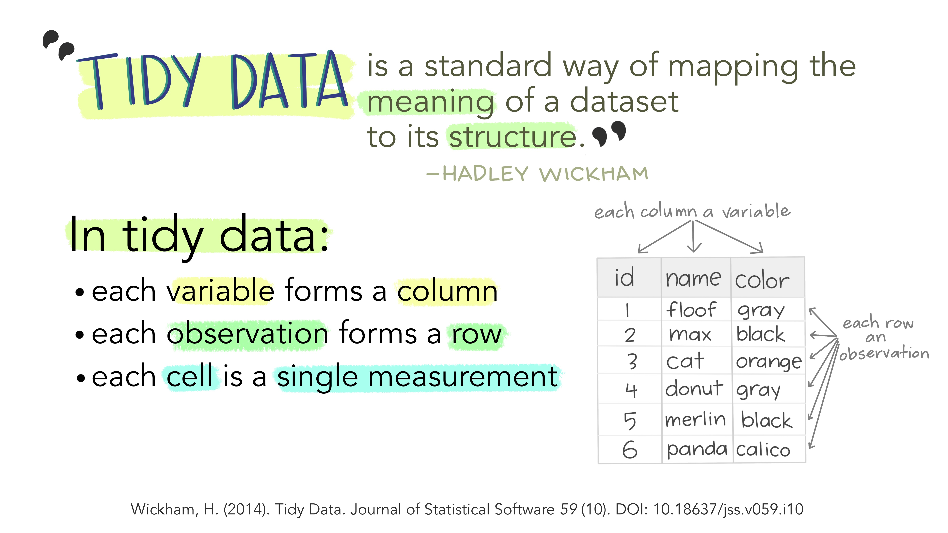
Tidy data

Slide 4
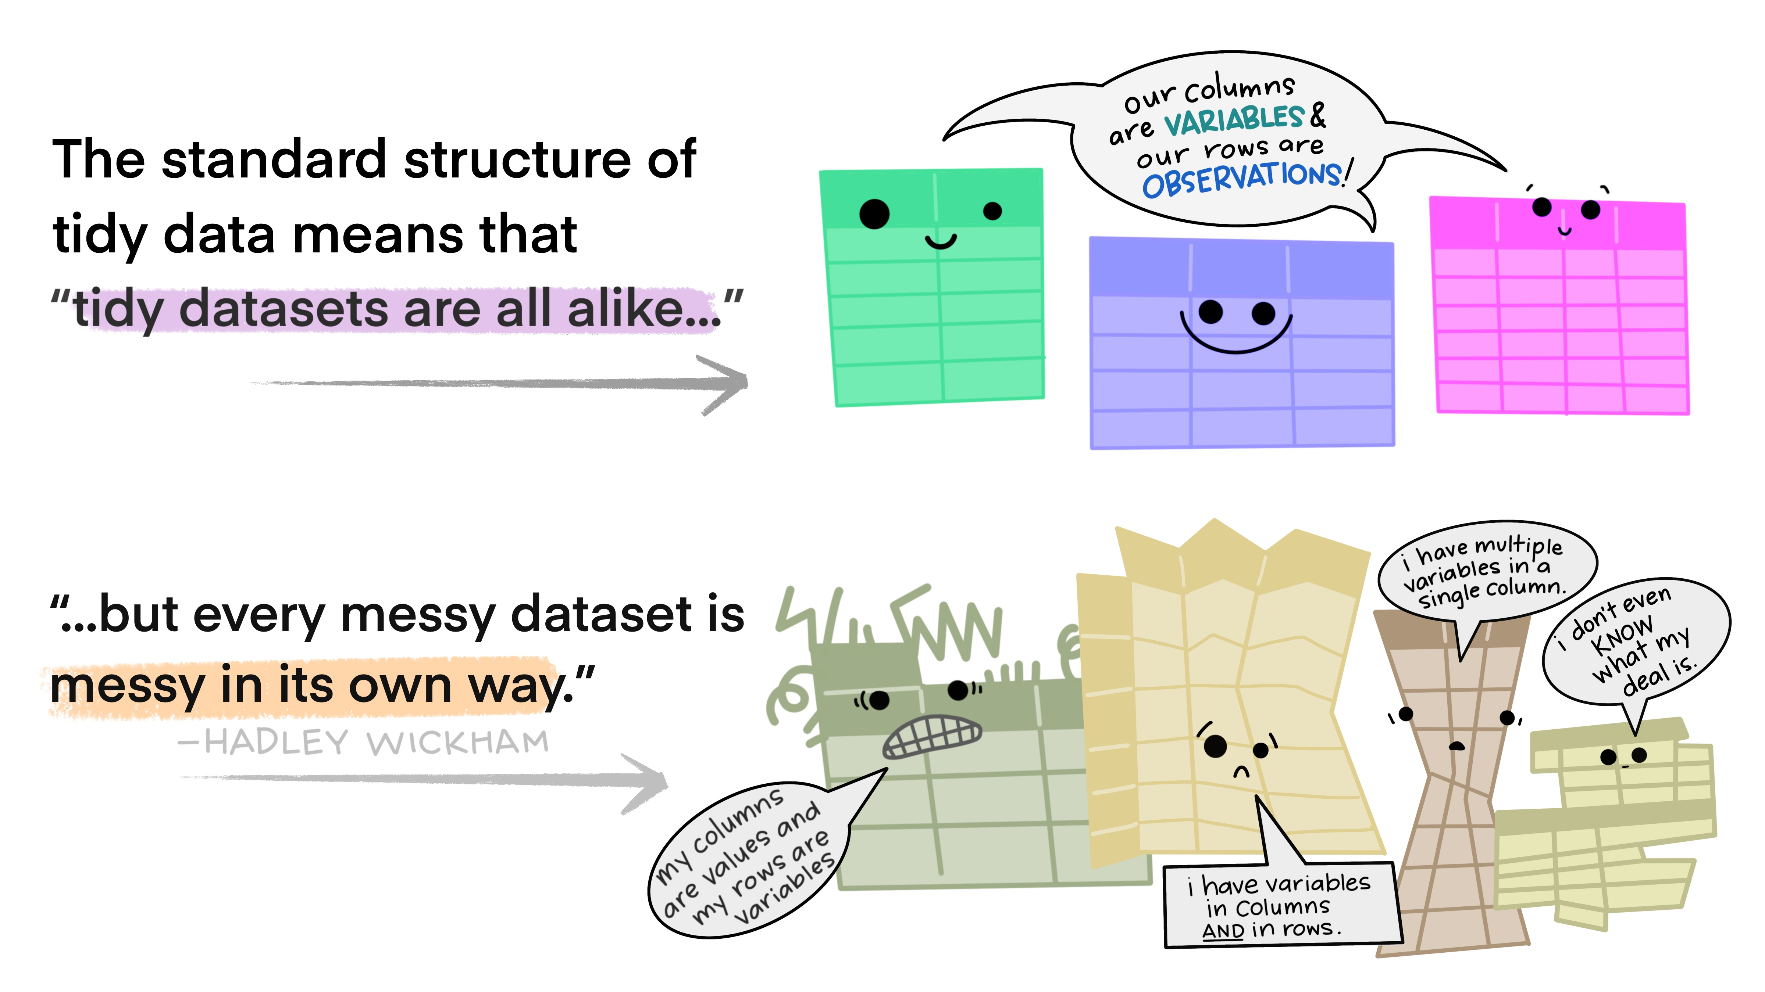
“Tidy datasets are all alike … every messy dataset is messy in its own way”

Slide 5
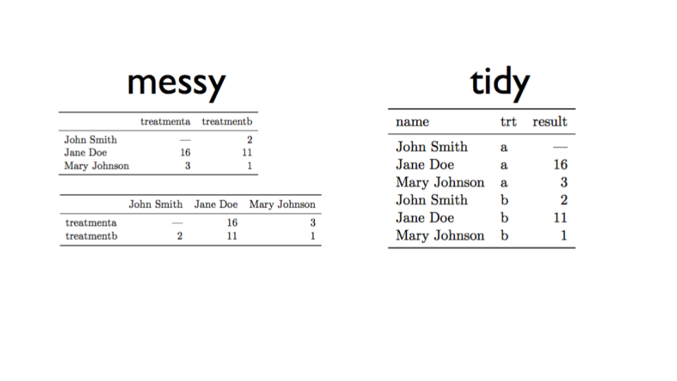
Tidy data example from here

Slide 6
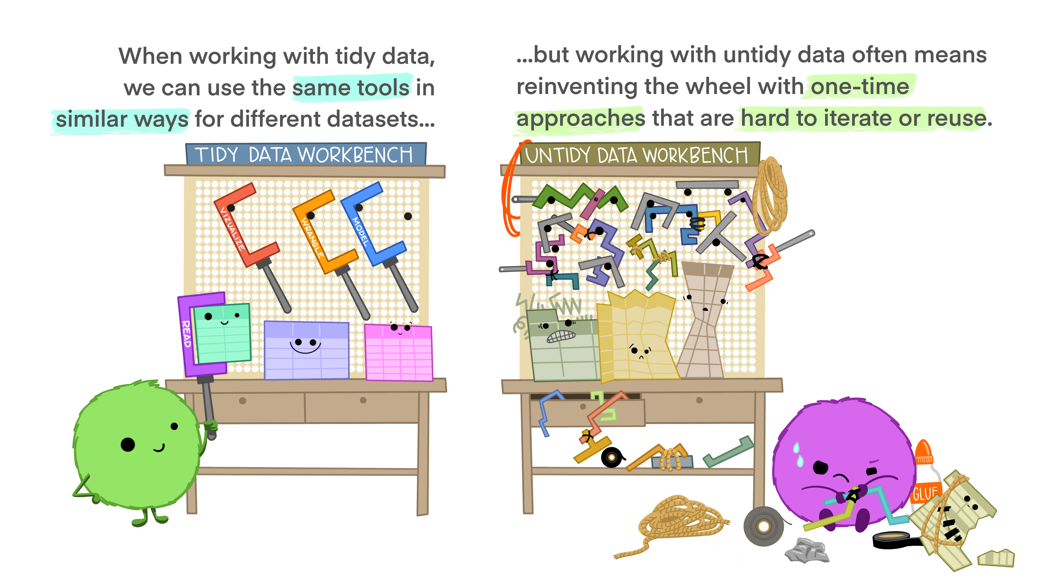
Tidy data allows approaches to be re-used

Slide 7

Tidy data allows for easier sharing, both with others & your future self

Slide 8
# Credit for stats cartoons
Artwork by @allison_horst
https://github.com/allisonhorst/stats-illustrations
https://www.openscapes.org/blog/2020/10/12/tidy-data/

Slide 9
Other main good practice
Keep data rectangular
Never try to record more than one “type” of thing in a column
Just one header row
Put units in column heading, not in individual cells

Slide 10
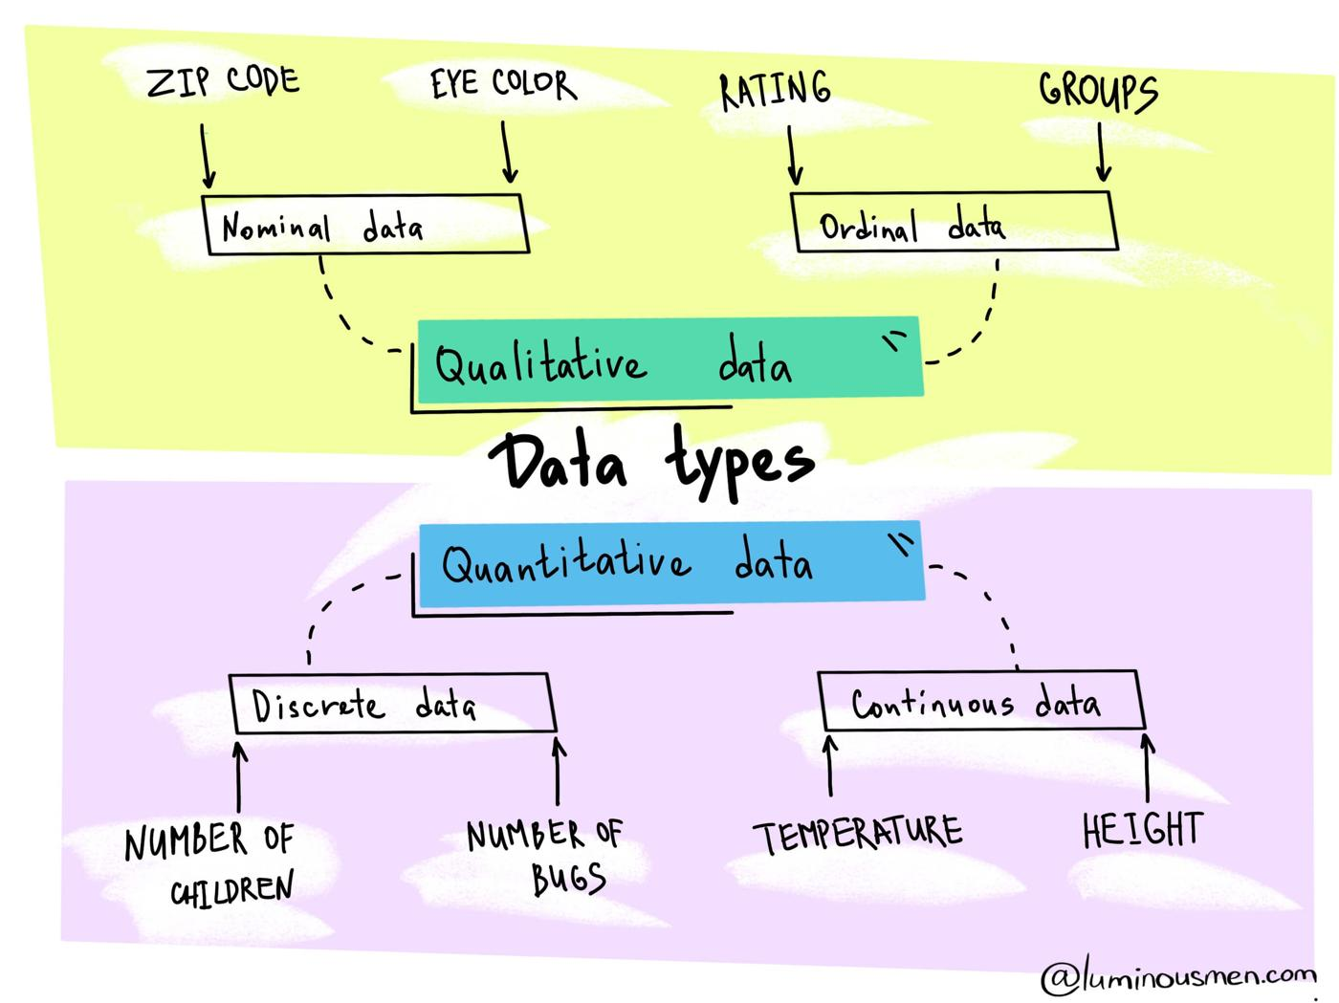
Data types

Slide 11
Data types
Integers & Decimals
...,-3,-2,0,1,2,3,... versus 3.141529
Whole numbers versus any number with a decimal point
Characters & Strings (any sequence of characters)
Literally anything you can type can be represented as a string.
Default type in Excel & in R if it can’t be recognised as anything else
180mg is not a number!

Slide 12
Data types (contd)
Dates & Times (beware tricky!)
- Try to use ISO 8601 date format : YYYY-MM-DD - Many advantages - e.g. 2021-08-23 - YYYY-MM-DD HH:MM:SS optional time added NOT : 2021:08:23 or 20210823 or 21-08-23
computers (e.g. Excel & R) store dates in a range of ways
problems occur in conversions
Package lubridate in R is good

Slide 13
Data types (contd)
TRUE or FALSE (Booleans)
TRUE or FALSE statements.
1 or 0 is a common shorthand
in R you may see T or F used. DON’T (can lead to problems because T & F can be redefined)

Slide 14
Categorical or Factor data
Sometimes R can convert character strings to Factors
Common source of confusion in R (still trips me up sometimes)
Nominal
An unordered factor
- apples, oranges, pears
R stores this as 1,2,3 for convenience but not because 1<2<3.
Ordinal
Ordered, e.g. Likert scale
- Disagree, Neither agree/disagree, Agree
R stores this as 1,2,3 for convenience and understands that 1<2<3

Slide 15
Exploring Datatypes in RStudio
Your turn …
In RStudio,
integers <- as.integer(c(1, 3, 15, 16)) decimals <- c(1.4, 3.5, 15.55, 16.4) bools <- c(TRUE, TRUE, FALSE, TRUE) dates <- as.Date(c("22/04/2016", "13/05/1997"), format = "%d/%m/%Y") strings <- c("These are", "Strings") factors <- as.factor(c("Apples", "Pears", "Lemons")) factors <- as.factor(c("Good", "Better", "Best"), ordered=TRUE)
then use str() to see the data ‘structure’

Slide 16
Cardinal rules for data in spreadsheets
Columns
Put all your variables in columns - the thing you’re measuring, like ‘weight’, ‘temperature’ or ‘SBP’. Break things down into their most basic constituents, and keep units in your headers only.
Rows
Put each observation in its own row. Think very carefully about what constitutes your basic observation. Often it’s your patient, but it may not be as intuitive as you think.

Slide 17
Headers
Have a single ‘header’ row to label your columns
Cells
Don’t combine multiple pieces of information in one cell.
Leave the raw data raw - don’t mess with it! That means no formulas anywhere in your spreadsheet!
Sharing
Export the cleaned data to a text based format like CSV. This ensures that anyone can use the data, and is the format required by most data repositories.

Slide 18
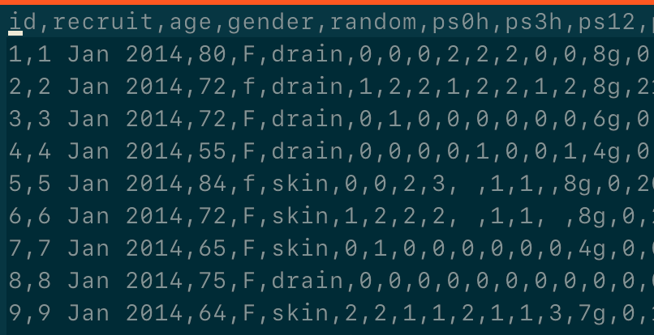
The computer doesn’t care about formatting

Slide 19
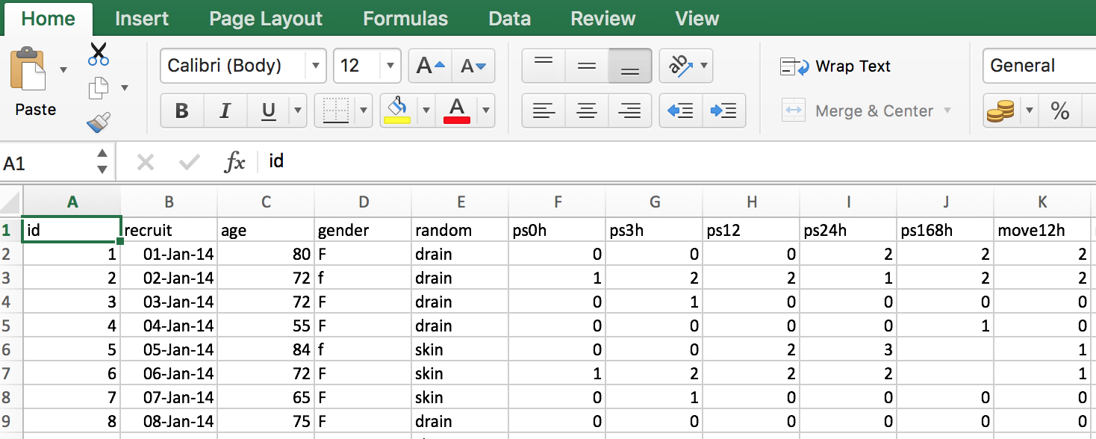
We do … all Excel does is present it to us in an easy to use format

Slide 20
But …
Remember that you need to go back and forth between both formats.
So merged cells, colours, comments will both be lost and confuse.

Slide 21
Your turn …
The data
Raw data from an RCT on pain relief following mastectomy
Download from FigShare.

Slide 22
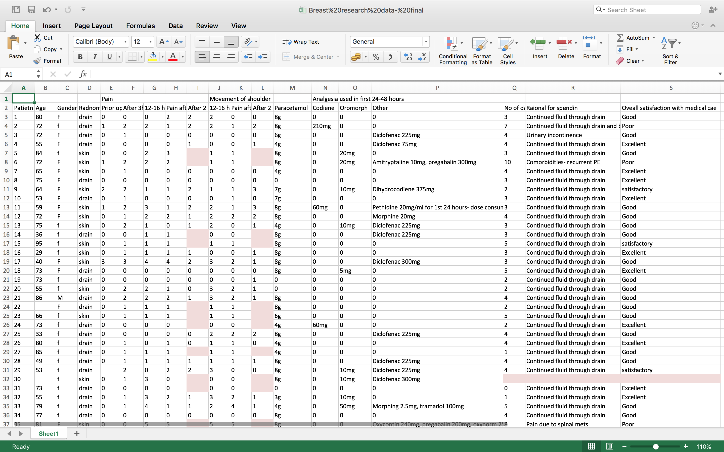
Original (dirty)

Slide 23
Your mission …
Identify and fix these common mistakes

Slide 24
Common mistakes
Multiple tables
Multiple tabs
Not filling in zeros
Using bad null values
Using formatting to convey information
Using formatting to make the data sheet look pretty
Placing comments or units in cells
More than one piece of information in a cell
Field name problems
Special characters in data
Inclusion of metadata in data table

Slide 25
Tips
First copy the spreadsheet - don’t mess with the raw data !
In the copy make 3 sheets: readme, dictionary, data
For this example modify the data in Excel - when you get more proficient you can do from R
Start with a few columns, don’t need to do all
Finally export the data sheet to CSV
For extra points, try reading the CSV into R with read_csv(“[filename.csv]”)

